Slide 1
Maximum Flow Algorithm
Network Specification using Graph
A finite digraph G = (V,E) with no self loops and parallel edges
Two vertices s and t are specified, s is the source node and t is the sink node
Each edge e є E is assigned a non-negative number C(e) called the capacity of e

Slide 2
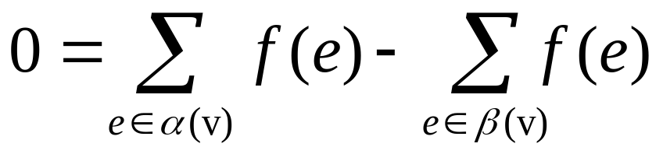
Flow Function
A flow function f is an assignment of a real number f(e) to each edge e, such that the following conditions are satisfied:
For every edge e є E, 0 <= f(e) <= C(e)
Let α(v) and β(v) be the sets of edges incoming and outgoing from v, respectively. For every v є V – {s, t}

Slide 3
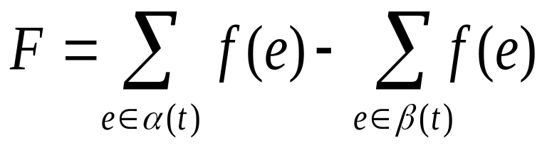
Total flow
= Difference between incoming
and outgoing flow at the sink node
S: A subset of V such that s is an element of S and t is not an element of S
S’ = Complement of S
= V – S
(S : S’) = Set of edges of G whose start vertex is in S and end vertex is in S’.
(S’ : S) = Defined similarly as above

Slide 4
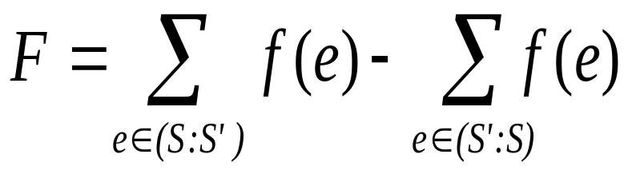
Observations
For every S,

Slide 5
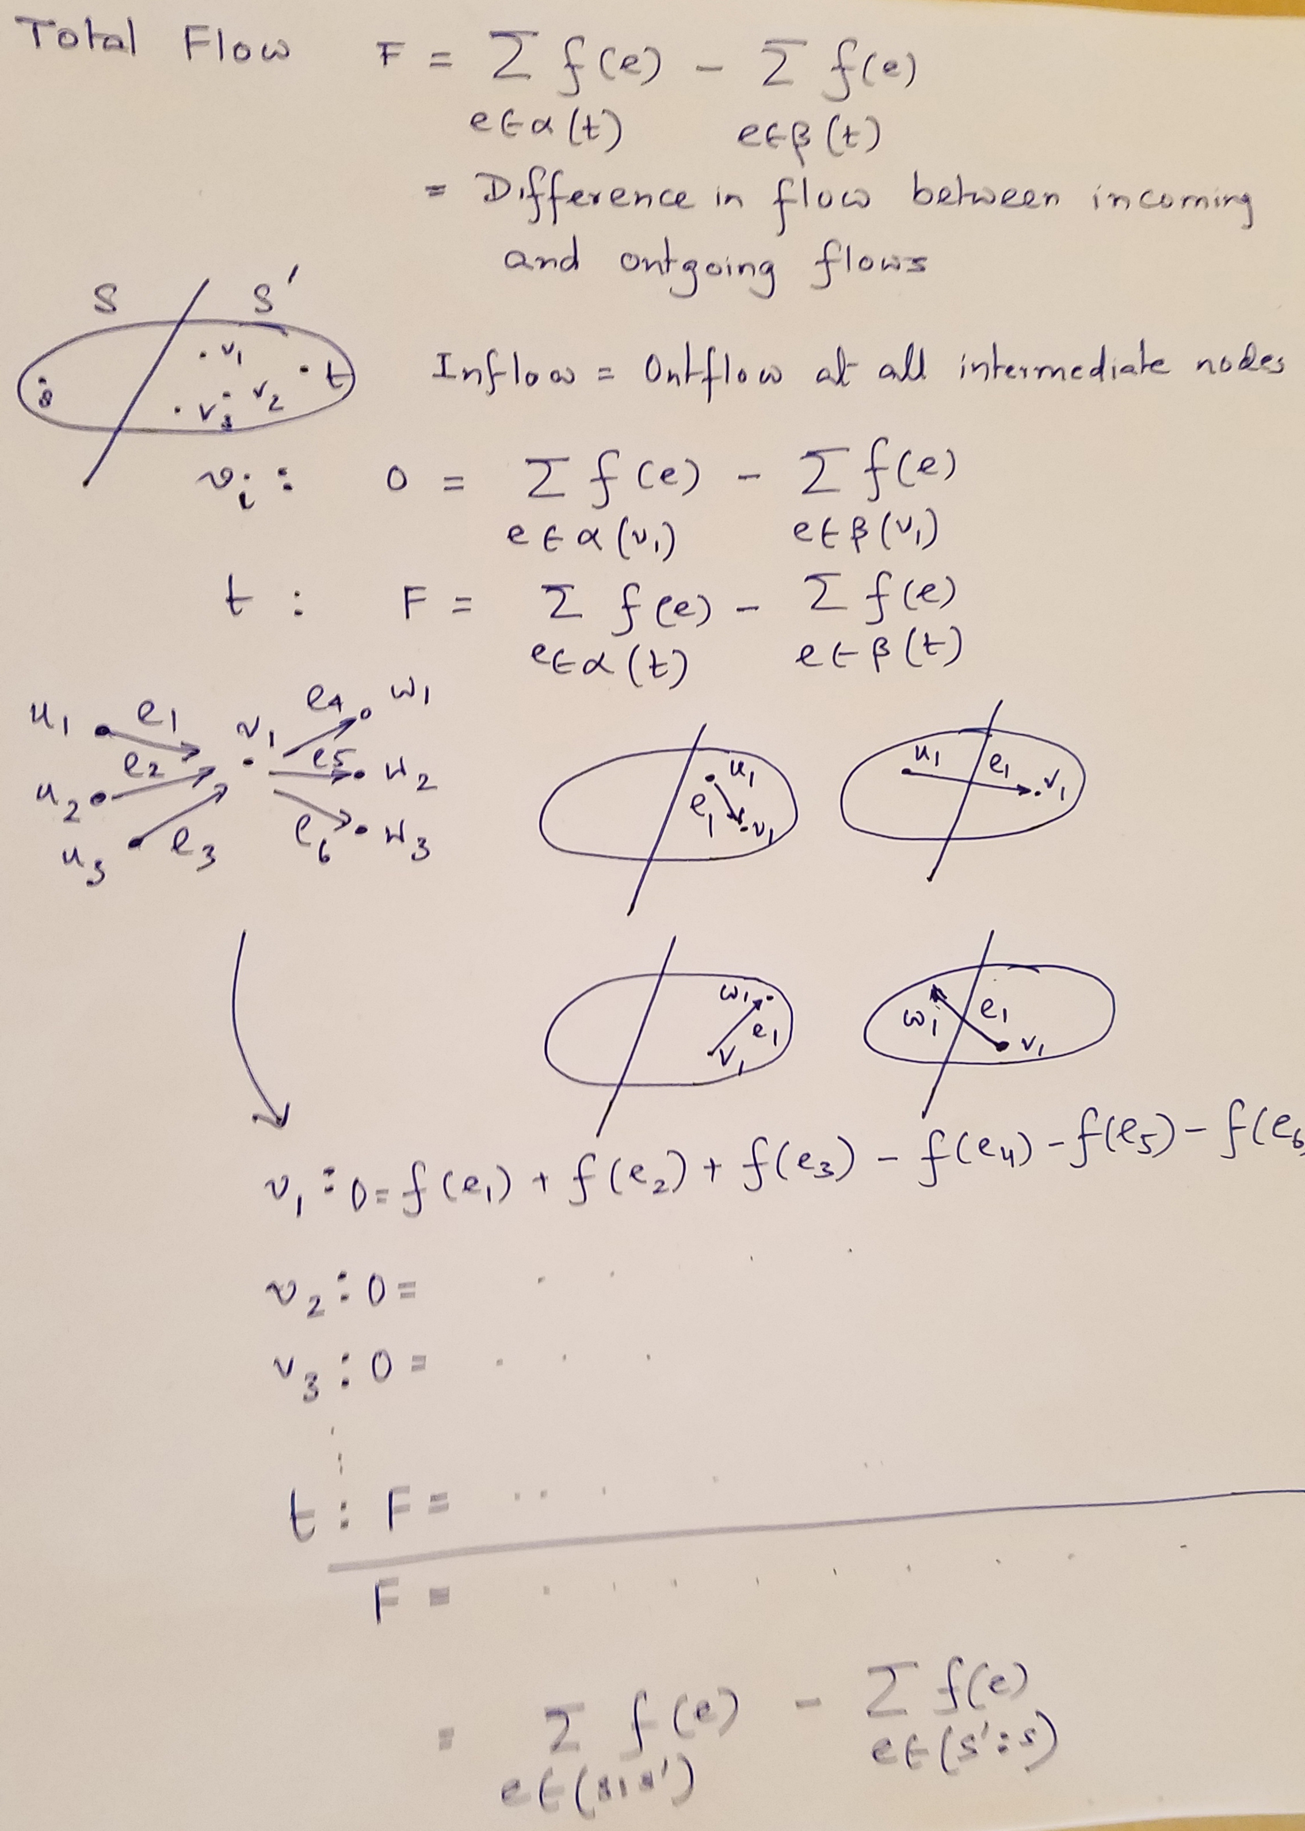

Slide 6
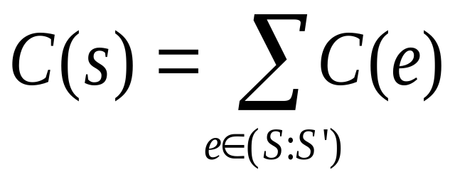
Observations
For every S,
Capacity of the cut determined by S is defined as

Slide 7
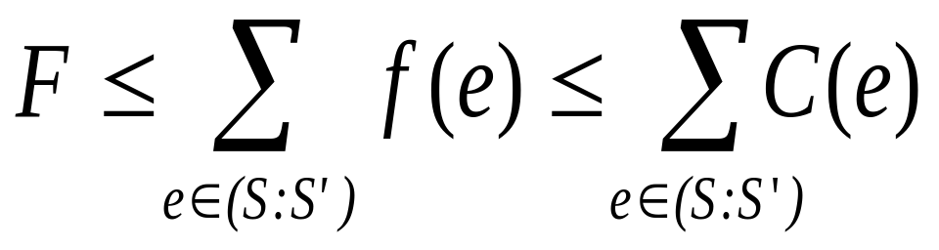
Observations
For every flow function f, with total flow F, and every S, F ≤ C(S)
F ≤ capacity of min cut
Max Flow = Min Cut

Slide 8
Augmenting Path
An augmenting path is a simple path from s to t,
which is not necessarily directed, but can be used
to advance flow from s to t.
Labeling Algorithm
Ford-Fulkerson Method (C, s, t)
Initialize flow f to 0.
While there exits an augmenting path P do: Augment flow f along P.
Return f.

Slide 9
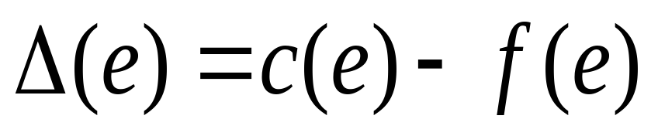
Forward Labeling
u e v
Forward Labeling of a vertex v by the edge e is
applicable if
u is labeled and v is not
C(e) > f(e)
The label that v gets is “e”. If e is used for forward
labeling we define

Slide 10
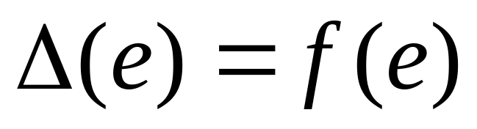
Backward Labeling
u e v
Backward Labeling of a vertex v by the edge e is
applicable if
u is labeled and v is not
f(e) > 0
The label that v gets is “e”. In this case we define:

Slide 11
Ford Fulkerson Algorithm
Assign some legal initial flow to the edges; an assignment f(e)=0 to every e will do.
Mark s ‘labeled’ and all other vertices ‘unlabeled’.
Search for a vertex v which can be labeled by either a forward or a backward labeling. If none exists, halt; the present flow is maximum. If such a vertex v exists, label it ‘e’, where e is the edge through which the labeling is possible. If v = t, go to step(4); otherwise repeat step(3).

Slide 12
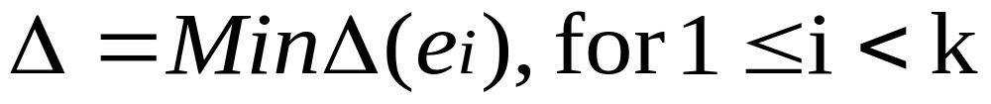
4. Starting from t and by the use of the labels, backtrack the path through which the labeling reached t from s. Let this path be
s = v₀ ^{e1} v₁ ^{e2} … ^{e3} v_{k} = t
(The directions of the edges may be in either direction.)
Let,

Slide 13
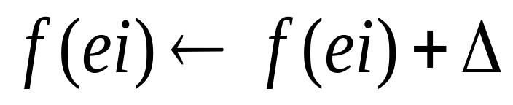
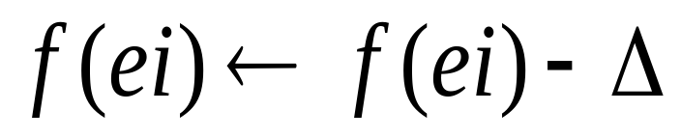
If e_{i} is forward, i.e.,
v_{i-1} ^{e}_{i} v_{i}
then
If e_{i} is backward, i.e.,
v_{i-1} ^{e}_{i} v_{i}
then
5. Go to step 2.

Slide 14
Computational Complexity of Ford-Fulkerson Algorithm
A
M
M
s
1
t
M
M
B
Augmenting Path 1: s → A → B → t
Flow can be augmented by 1 unit
Augmenting Path 2: s → B A → t
Flow can be augmented by 1 unit
The number of augmenting paths computed = 2M

